Slide 1
Common Immunizable Diseases
Continuation: Polio, Chicken Pox, Diphtheria, Pertussis

Slide 2
POLIO

Slide 3
Poliomyelitis (Polio)
It is a highly infectious viral disease
Polio virus is a non-enveloped virus having the shape of an icosahedral capsid (Spherical) and from Picornaviridae
Mainly affects the young children
Mode of transmission is mainly through the faecal-oral route, i.e., contaminated food and water
The virus multiplies in the intestine from where it invades the nervous system and can cause paralysis
The initial symptoms of the disease include fever, fatigue, headache, vomiting, ….then stiff neck, and pain in the limbs
The disease causes paralysis in its most severe form, which is permanent.
NB, there is no cure for polio, it can only be prevented by immunization.

Slide 4
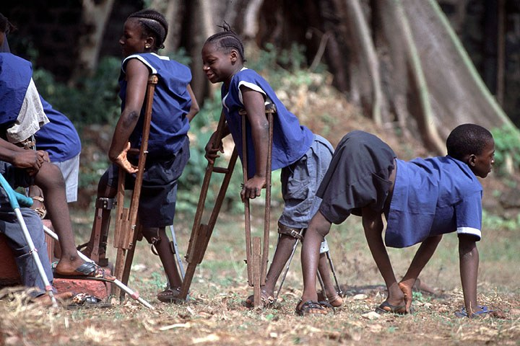
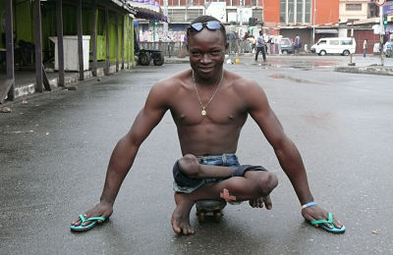

Slide 5
Diagnosis is as per WHO case definition
“ A case of poliomyelitis is defined as any child under fifteen years of age with acute flaccid paralysis or any person with paralytic illness at any age when polio is suspected”
Acute Flaccid Paralysis is defined as sudden onset of weakness and floppiness in any part of body in a child <15 years or paralysis in a person of any age in whom polio is suspected

Slide 6
The infection Cycle
Agent
Poliovirus : three serotypes (P1, P2, P3) with different antigenicity
The virus can live in water for three months and in the faeces for six months.
The poliovirus is rapidly inactivated by heat, formaldehyde, chlorine and ultraviolet light.
Reservoir
Cases : clinical & subclinical plays a role in the spread of infection
Carriers: faecal temporary. There is no chronic carrier.
Source of infection:
Faeces and pharyngeal secretions of the infected person

Slide 7
Immunity in Polio
Transplacentally acquired passive immunity
After natural infection
After immunisation
Local immunity

Slide 8
Immunity to Poliovirus Infection
Exposure to poliovirus initiates a complex process that eventually results in both humoral (systemic) and mucosal (local) immunity.
Poliovirus infection provides lifelong immunity against the disease, but this protection is limited to the particular type of poliovirus involved (Type 1, 2, or 3)
Thus, infection with one type does not protect an individual against infection of the other two types. IgM and IgG antibodies are detected in the serum as early as 1-3 days following natural infection but disappears after 2-3 months.

Slide 9
Oral polio vaccine
Contains 3 serotypes of vaccine virus
Grown on monkey kidney (Vero) cells
Contains magnesium sulfate, phenolphthalein
Heat sensitive – to be stored at –20⁰ c
Stored at 2-8⁰ c during administration

Slide 10
continuation
Live, attenuated oral poliovirus vaccine (OPV) were developed in the 1950s
Advantages including
cost
ease of administration
transmission of vaccine virus to unimmunized contacts
It is the vaccine currently recommended by the (WHO) Expanded Program on Immunization (EPI).
The trivalent form of OPV has been the mainstay of EPI and the WHO Polio Eradication Program for many years, but type 1 and type 3 monovalent OPV vaccines have recently been introduced

Slide 11
Oral polio vaccine
Shed in stool for up to 6 weeks following vaccination – Herd immunity
Seroconversion rates of 73%, 90% and 70% for 1, 2, 3 serotypes after 3 doses
Doses are given at 2 months, 4 months, 6-18 months and then at 4-6 years. The first dose may be given as early as 6 weeks
Type 2 serotype disappears first with immunization

Slide 12
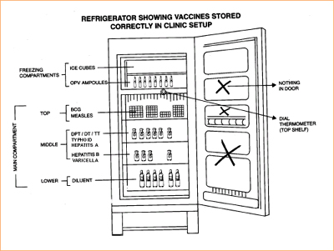

Slide 13



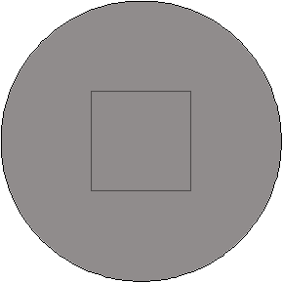




VACCINE VIAL MONITOR
X
1 = good: Utilize
3 = bad: Don’t Utilize
X
2 = good: Utilize
4 = bad: Don’t Utilize
The central square is lighter than the surrounding circle
The central square is equal to, or darker than the surrounding circle

Slide 14
Differences between IPV and OPV
Killed formalised virus | Live attenuated
SC/IM | Oral
Circulating AB +, NO INTESTINAL IMMUNITY | HUMORAL+ INTESTINAL
Prevents paralysis but not re-infection | Prevents paralysis and intestinal re-infection
No use epidemics | Useful
Can be given in HIV, no VAPP | VAPP +,not in immunocompromised
No stringent storage conditions, longer shelf –life | Stored and transported at sub-zero
No herd immunity | Herd immunity +

Slide 15
Continuation
IPV is prepared by inactivation of naturally occurring polioviruses by treatment with dilute formalin.
Trivalent IPV is the only vaccine available for routine infant and childhood immunization in the United States
It is now the preferred vaccine for other developed countries because, unlike OPV, it does not cause vaccine associated paralytic poliomyelitis

Slide 16
Immune response and efficacy
After OPV
Neutralizing antibodies are detectable to all three poliovirus types in >93 percent of recipients after two doses, and 100 percent after the third dose
Detectable antibody persists at protective levels for at least five years
IPV protection rates for recipients of one and two doses (36 and 89 percent, respectively)

Slide 17
Oral polio vaccine-Adverse reactions
Vaccine associated paralytic poliomyelitis(VAPP)-250 to 800 cases annually-1/5 million doses
Most common by type 2
Circulating vaccine derived polio viruses (cVDPV)-out breaks of paralytic polio

Slide 18
Polio is suitable to be eradicated for the following reasons
Polio only affects humans, there are no known animal reservoirs
An effective, inexpensive vaccine is available: Oral Polio Vaccine (OPV)
Immunity is life long
There are no chronic carriers
Half life of excreted virus in the sewage is 48hrs ( spread occurs only during this period)

Slide 19
Before a WHO region can be certified polio-free, three conditions must be satisfied:
There are at least three years of zero polio cases due to wild poliovirus;
Disease surveillance efforts in countries meet international standards; and
Each country must illustrate the capacity to detect, report and respond to “imported” polio cases

Slide 20
What is Post Polio Syndrome ?
It is the late manifestation of acute paralytic polio.
25-40% of people who had paralytic polio15-40yr previously.
They show symptoms of muscle and joint pain, general fatigue and weakness.
Three indications of PPS:
A. Previous diagnoses of polio
B. Long interval following recovery: people usually live long
but effect can occur during 30-35 years after the diagnoses.
C. Gradual onset: weakness that tends to be perceptible until it
interferes with daily activities.

Slide 21
Criteria For Diagnosis of Post Polio Syndrome
A prior episode of paralytic poliomyelitis.
EMG evidence of longstanding denervation.
A period of neurologic recovery and functional stability preceding the onset of new problems (Usually >20 years).

Slide 22
Strategies of polio eradication
There are four core strategies to stop transmission of the wild poliovirus
A-Routine immunization of infants
B-Supplementary immunization
National immunization days ( EPI)
Mopping up immunization ( EPI)
C- Surveillance Acute flaccid paralysis and mop-up vaccination campaigns.
D-An effective virological laboratory

Slide 23
CHICKEN POX

Slide 24
Chicken Pox is caused by the Varicella Zoster Virus, which is a DNA enveloped virus from the Herpes Virus family
It used to be a very common childhood illness,
But thanks to the Varicella vaccine, it is now under control
The virus has only one serotype

Slide 25
Transmission is via the respiratory droplets and
also by contact with the lesions
Varicella is a highly contagious disease of childhood
The appearance of either varicella or zoster in a hospital is a major infection control problem because the virus can be transmitted to immunocompromised patients and cause life-threatening disseminated infection.
VZV infects the mucosa of the upper respiratory tract, and then spreads via the blood to the skin, where the typical vesicular rash occurs

Slide 26
The rash evolves from papules to vesicles, pustules, and, finally, crusts. Itching (pruritus) is a prominent symptom, especially when vesicles are present.
Varicella is mild in children but more severe in adults
Reye’s syndrome, characterized by encephalopathy and liver degeneration, is associated with VZV and influenza B virus infection, especially in children given aspirin. Its pathogenesis is unknown

Slide 27
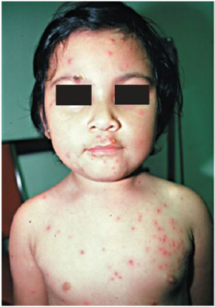

Slide 28
Most diagnoses are made clinically
Presumptive diagnosis can be made by using the Tzanck smear
The definitive diagnosis is made by isolation of the virus in cell culture and identification with specific antiserum.

Slide 29
Vaccine
There are two vaccines against VZV:
One designed to prevent varicella, called Varivax
and the other designed to prevent zoster, called Zostavax.
Both contain live, attenuated VZV, but the zoster vaccine contains 14 times more virus than the varicella vaccine.
The zoster vaccine is effective in preventing the symptoms of zoster, but does not eradicate the latent state of VZV.
The vaccine against chicken pox is given when children are 12 to 15 years old then a booster shot given when they are 4 to 6 year old.

Slide 30
The varicella vaccine is recommended for children between the ages of 1 and 12 years, whereas the zoster vaccine is recommended for people older than 60 years and who have had varicella.
The varicella vaccine is given in two doses, whereas the zoster vaccine is given in one dose.
Because these vaccines contain live virus, they should not be given to immunocompromised people or pregnant women.
Varicella-zoster immune globulin (VZIG), which contains a high titer of antibody to the virus, is also used for such prophylaxis.

Slide 31
DIPHTHERIA

Slide 32
Corynebacteria are gram-positive rods that appear club-shaped (wider at one end and are arranged in palisades or in V- or L-shaped formations.
The rods have a beaded appearance.
Humans are the only natural host of C. diphtheriae.
Both toxigenic and nontoxigenicorganisms reside in the upper respiratory tract and are transmitted by airborne droplets.

Slide 33
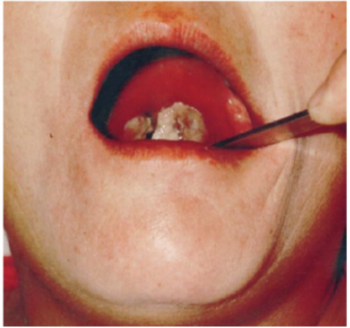

Slide 34
Clinical findings and Diagnosis
It causes a the thick, gray, adherent pseudomembrane over the tonsils and throat
Cutaneous diphtheria causes ulcerating skin lesions covered by a gray membrane
Laboratory diagnosis involves both isolating the organism and demonstrating toxin production.
A throat swab should be cultured on Loeffler’s medium, a tellurite plate, and a blood agar plate. The tellurite plate contains a tellurium salt that is reduced to elemental tellurium within the organism. The typical gray-black color of tellurium in the colony is a diagnostic criterion.

Slide 35
Treatment and Vaccination
The treatment of choice is antitoxin, which should be given immediately on the basis of clinical impression
Diphtheria toxoid (usually given as a combination of diphtheria toxoid, tetanus toxoid, and acellular pertussis vaccine, often abbreviated as DTaP).
Diphtheria toxoid is prepared by treating the exotoxin with formaldehyde. This treatment inactivates the toxic effect but leaves the antigenicity intact.
Because immunity wanes, a booster every 10 years is recommended. Immunization does not prevent nasopharyngeal carriage of the organism.

Slide 36
Age of vaccination
First dose -6 weeks
Second dose-10 weeks
Third dose -14 weeks
First booster-12-18 months
Second booster- 5 years some as DT others DPT

Slide 37
PERTUSIS

Slide 38
Bordetella pertussis causes whooping cough (pertussis)
B. pertussis is a small, coccobacillary, encapsulated gram-negative rod.
B. pertussis, a pathogen only for humans, is transmitted by airborne droplets produced during the severe coughing episodes.
Pertussis is a highly contagious disease that occurs primarily in infants and young children and has a worldwide distribution.

Slide 39
Whooping cough is an acute tracheobronchitis that begins with mild upper respiratory tract symptoms followed by a severe paroxysmal cough, which lasts from 1 to 4 weeks.
The paroxysmal pattern is characterized by a series of hacking coughs, accompanied by production of copious amounts of mucus, that end with an inspiratory “whoop” as air rushes past the narrowed glottis.

Slide 40
The classic picture of whooping cough described occurs primarily in young children.
In adults, B. pertussis infection often manifests as a paroxysmal cough of varying severity lasting weeks. The characteristic whoop is often absent, leading to difficulty in recognizing the cough as caused by this organism.
In the correct clinical setting, adults with a cough lasting several weeks (often called the 100-day cough) should be evaluated for infection with B. pertussis.

Slide 41
The organism can be isolated from nasopharyngeal swabs taken during the paroxysmal stage.
Bordet-Gengou medium used for this purpose contains a high percentage of blood (20%–30%) to inactivate inhibitors in the agar.
PCR, Fluorescent antibody staining also used
Azithromycin used for treatment

Slide 42
VACCINATION
There are two types of vaccines:
an acellular vaccine containing purified proteins from the organism and
a killed vaccine containing inactivated B. pertussis organisms.
The acellular vaccine contains five antigens purified from the organism.
It is the vaccine currently used in the United States
The main immunogen in this vaccine is inactivated pertussis toxin (pertussis toxoid). The toxoid in the vaccine is pertussis toxin that has been inactivated genetically by introducing two amino acid changes, which eliminates its ADP-ribosylating activity but retains its antigenicity.

Slide 43
It is the first vaccine to contain a genetically inactivated toxoid. The other pertussis antigens in the vaccine are filamentous hemagglutinin, pertactin, and fimbriae types 2 and 3.
The acellular vaccine has fewer side effects than the killed vaccine but has a shorter duration of immunity.
The pertussis vaccine is usually given combined with diphtheria and tetanus toxoids (DTaP) in three doses beginning at 2 months of age

Slide 44
Because outbreaks of pertussis have occurred among teenagers, a booster for those between 10 and 18 years old is recommended. This vaccine, called Boostrix, contains diphtheria and tetanus toxoids also.
Another vaccine called Adacel also contains diphtheria and tetanus toxoids. A pertussis booster dose is recommended for adults as well.
To protect newborns, pregnant women should receive pertussis vaccine.

Slide 45
Antipertussis IgG will pass the placenta and protect the newborn.
The killed vaccine is no longer used in the United States because it is suspected of causing various side effects, including postvaccine encephalopathy at a rate of about one case per million doses administered.
The killed vaccine is in use in many countries other than the United States.
Azithromycin is useful in prevention of disease in exposed, unimmunized individuals. It should also be given to immunized children younger than 4 years who have been exposed because vaccine-induced immunity is not completely protective.

Slide 46
PENTAVALENT VACCINE
Storage and administration
The vaccine is best stored at +2-+8 degree Celsius
Given as deep IM over the lateral thigh or deltoid
Vaccine contraindicated in cases of progressive neurological disease

Slide 47
COMPLICATIONS
Fever rise to 40.5 within 48 hours-1:330
Convulsions within 3 days 1:1750
Persitent severe unconsolable screaming or crying for over 3 hours 1:100
Hypotonic-hypo responsive episode within 48 hours 1:1750
Local sterile injection abscess
Allergic skin reaction
Pseudotumour cerebri
Encephalitis

Slide 48
THANK YOU

